Slide 1

CANADIAN
NATIONAL MASTER
CKC MASTER HUNT TESTS
2018
(Short Version)
Notes:
Sources For Good Information on Judging, Field Work and Setting up Good Tests
(Copy links into your browser)
Retriever Field Trial Judging – A Manual - “The Blue Book” Aimed at field trial judges but carries a large amount of information that would translate well to hunt tests and WC/I/X work
https://www.theretrievernews.com/store/p7/Judge%27s_Manual_%28Digital_eBook_Edition%29.html
Retrievers ONLINE - Dennis Voigt has published many outstanding articles on judging in his Retrievers ONLINE magazine and currently appear on his blog.
http://www.retrieversonline.com/
Retriever Field Trial Judging Fundamental and Checklist
http://cdn.agilitycms.com/retrievers-online/AMJ_2012_Judging%20Checklist-hi%20res.pdf
Retriever News
https://www.theretrievernews.com/
CKC Rules and Regulations
https://www.ckc.ca/en/Files/Forms/Shows-Trials/Event-Rules-Regulations/Hunt-Test-Rules-and-Regulations-for-Retrievers-Bar
It is easy to set up tests that eliminate dogs - all dogs can be tricked – but that is not the role of a judge. Judges should be on the dog’s side when judging – not to give it an easy pass – but to bring out the best that dog has to offer on that day.

Slide 2
Table of Contents
TOPIC | SLIDE
Purpose of CKC Hunt Tests | 3
Key Hunt Test Definitions | 4 - 6
Master Test Requirements | 7
Master Test Design Considerations | 8 - 13
Evaluating the Master Dog General Lining the Dog Talking to the Dog Recasting the Dog Handling on Marks Interference Switching on Marks Hard Mouth Sample Master Score Sheets | 14 - 28

Slide 3
Purpose of CKC Hunt Tests
The purpose of the hunt test for Retrievers, Barbet, Irish Water Spaniels and Standard Poodles is to test the merits of, and evaluate the abilities of these dogs in the field in order to determine their suitability and ability as hunting companions
Hunt tests should, therefore, simulate as nearly as possible the conditions met in a true hunting situation
- Section 13.1.1 of CKC Rules and Regulations
The purpose of the Master Hunt Test is (also) to maintain the quality of the program
- Section 11.2.1 (a) of CKC Rules and Regulations

Slide 4
Key Hunt Test Definitions
Break
  Dog leaves to retrieve without release by handler and is not brought under control
Controlled Break
  Dog leaves to retrieve without release by handler but is quickly brought under control verbally or by whistle and returns
  In Master, a controlled break calls for a “0” score except in the Upland series where it is considered a minor fault when the dog is brought under immediate control
Creeping
  Leaving the handler on a tentative yet excited basis, short of leaving completely
  General unsteadiness
  Can be a safety issue
Notes:
Break
A break occurs when a dog makes a movement which, in the opinion of the judges, indicates a deliberate intent to retrieve without having been ordered to do so, and cannot be brought under control by the handler
Controlled break
Controlled break is when a dog leaves before being sent but is quickly brought under control by verbal command or whistle and returns to the handler
Discussion should take place at this time on controlled breaks. Controlled break can also occur when the dog stops on its own without handler communicating verbally. If the dog is watching the marks, leaves the handler’s side stops a few feet or more without handler saying sit of whistling, this is a controlled break. Controlled breaks are only while marks are going down or in Master on the sit to flush.
Creeping
Creeping is considered as leaving the handler on a tentative yet excited basis, short of leaving completely to retrieve the bird, or waiting to be sent to retrieve. General unsteadiness short of breaking:
Creeping can be a safety issue in a real hunting situation.
As a guide in their instructions to participants, judges may wish to use a hypothetical creep line of “no creeping beyond the end of the gun barrel”.

Slide 5
Key Hunt Test Definitions Cont’d
Pop
  A pop, or popping, is voluntary stopping (without command) and looking back to the handler for direction after having been sent
Diversion Bird
  A bird that is thrown and acts to divert the dog from their task at hand as it occurs
  Occurs while the dog is actively working in the field as opposed to being at the line
Poison Bird
  A poison bird is a mark, seen from the line, that is left in the field while the dog picks up a blind
  If the judge chooses to have the poison bird picked up after delivery of the blind, it will be judged as a mark
Notes:
Popping
Popping is characterized as a voluntary stopping (without command) and looking back to the handler for direction.
Discussion could take place at this point with regards to whether a pop also constitutes a dog running/moving forward but glances back.

Slide 6
Key Hunt Test Definitions Cont’d
Recast
  Distance for an allowable recast should be agreed upon by judges but is usually limited to 15 feet or 4.5 meters
  Usually attributed to a dog’s confusion as to whether it was sent
    It is not considered a recast when a dog goes to the area of the fall, fails to find the bird and returns (or is recalled)
    This must be evaluated as a lack of perseverance
Refusal
  Refusal is a disregard of a command
    Failure to stop and look at the handler when signalled or failure to continue in new direction for a considerable distance both constitute a refusal
    Not coming when called is as bad as not going when sent
Notes:
Recast
Distance should be agreed upon by judges but is usually limited to 15 feet or 4.5 meters……
Discussion could take place with regards to some of the grey areas around recasts and no-gos. Did the dog hear the handler? How should the dog be evaluated?
Refusal
Refusal is disregard of a command. Failure to stop and look to the handler when signalled, failure to continue in that new direction for a “considerable” distance constitutes refusal. Not coming when called is as bad as not going when sent.
Discussion could take place at this point with regards to what is considered as a “considerable” distance – 3 feet, 5 feet, 10 feet?

Slide 7
Master Test Requirements
A minimum of 5 hunting situations shall be tested as follows:
  One set of multiple land marks
  One set of multiple water marks
  A land blind(s)
  A water blind(s)
  Upland hunting test with quarter and flush
Each of these hunting situations can be considered a “series”
  NOTE: The word “multiple” means more than once, although triple marks are encouraged
Notes:
The blinds may be run as a double blind, one placed on land and one placed on water.
In the Upland potion of the test, the dog may be urged to hunt or handled to maintain his range and position. The bird(s) must be placed in cover within the test area. When located, the birds must be retrieved by the dog to the handler. Dead birds shall be used.
- 9.2.1(e)

Slide 8
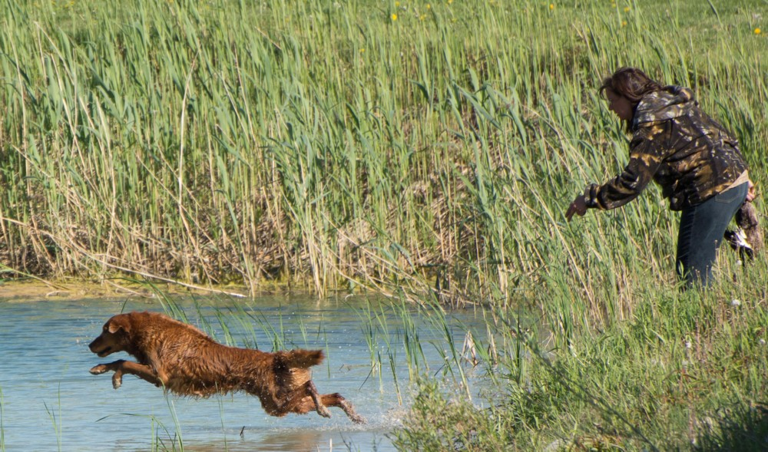
Master Test Design Considerations: General
Natural factors, obstacles and hunting equipment should be utilized to a greater degree than in a Senior test
A Master dog must honour at least once
No retrieve shall normally exceed 91.4 meters (100 yards) and will NEVER exceed 114.3 meters (125 yards)
As in Junior and Senior, situations must simulate natural and realistic hunting situations
Notes:
Discussion can take place on why visible gun stations should be kept to a minimum at Senior and Master tests.

Slide 9
Master Test Design Considerations: Diversions
Diversion birds and/or diversion shots must be used at least once
  A diversion shot takes place with no bird thrown
  A diversion bird is a bird that is thrown in addition to the marks and blinds when the dog is actively working in the field
Diversion birds on a BLIND may be shot or thrown after the dog has been sent, or when a dog is returning from a blind retrieve
Diversion birds on a MARK shall only be used when the dog is returning from a retrieve
Notes:
Diversions
A diversion bird is thrown while the dog is out actively working in the field, not on the line. It diverts the dog from their task at hand as the task occurs.
A poison bird is a mark as it is marked from the line. The term poison bird is used to describe the concept of leaving the mark in the field while picking up a blind.
Discuss why diversion birds are part of the test.

Slide 10
Master Test Design Considerations: Poison Birds
Poison birds may be used in the Master test and are marked from the line as opposed to when the dog is active in the field (diversion)
Judges will determine whether the poison bird shall be retrieved,
  At all;
  On the way to the blind; or
  After having picked up the blind retrieve
If the judge chooses to have the poison bird picked up, it will be judged as a mark
Notes:
Poison Birds
A poison bird is a mark as it is marked from the line. The term poison bird describes the concept of leaving the mark in the field while picking up a blind.
This is as opposed to a diversion which occurs while the dog is out actively working in the field, not on the line – i.e. to divert them from their task at hand AS IT OCCURS.

Slide 11
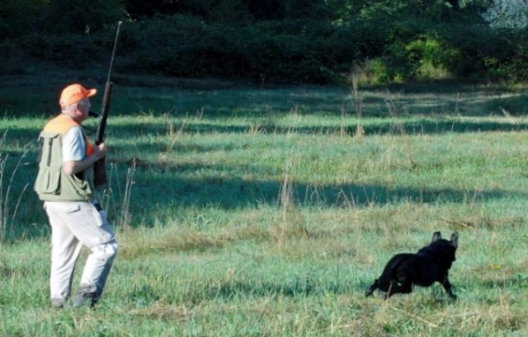
Master Test Design Considerations: Upland
In all Master tests, an upland hunt test with quartering and flush shall be used
The intent of the upland test is to demonstrate a natural tendency to quarter and hunt under control, NOT to demonstrate running a pattern
When quartering, the dog should hunt in a radius ideally 10 to 30 yards in front of the handler
The dog should be eager to hunt all available cover diligently and be under control
Notes:
At the host club’s discretion, a separate set of qualified judges (2) may be used to judge the upland hunting test. The CKC must be advised the day after the close of entries.

Slide 12
Master Test Design Considerations: Upland Cont’d
The dog may be urged to hunt or be handled to maintain his range and position but excessive handling is unacceptable
A natural flush is preferred but if a release device is used, it must be sufficiently camouflaged
When such devices are used the bird must be released in full view of the dog
The distance from the released bird to the dog should be within scenting distance
Whenever possible, the flush should be aimed away from the dog, not towards it
If birds are retrieved, they must be dead

Slide 13
Master Test Design Considerations: Upland Cont’d
Retrieves will NOT be scored as a mark but must be completed and must be delivered to hand
The dog may sit or stand with limited movement but will be disqualified if not steady to shot
The dog must be under control at the time the first shot is fired, or in the judge’s opinion, should have been fired
If a dog is steady to shot but then breaks at the fall, demonstrating an intent to retrieve without being sent, it must be stopped
  If brought under immediate control, it shall be considered a controlled break and a minor fault

Slide 14
Evaluating the Master Dog: General
A retriever’s prime purpose is to get bird to hand as quickly as possible in a pleasing and obedient manner using both natural and trained abilities
A Master test usually consists of 5 series:
  Land marks, Water marks, Land blind, Water blind, Quarter and flush (Upland)
In each series, each of the abilities must be assessed out of 10
  Marking
  Style
  Perseverance
  Training
These abilities will be scored against a standard as described in CKC Rules and Regulations and NOT in relation to other dogs
Notes:
These abilities (Marking, Style, Perseverance, trainability) will NOT be defined in relation to the performance of the other dogs but instead against the standard as set out in the CKC hunt test rules and regulations.
Judges should compare their scores early in the test and throughout the test to see if they are relatively consistent in their numbers.

Slide 15
Evaluating the Master Dog: General
Scores must be shown to handlers upon request
To qualify, an average score of 7 for the whole test (all series) must be achieved and must NOT include a score below 5 in any one ability (Marking, Style, Perseverance, Training)
When a dog is graded “0” by two judges on the same ability, it shall not be called back
A zero score is different from a non-score
  A “0” indicates that the dog had an opportunity to exhibit an ability but failed to do so
  A “non-score” indicates that an opportunity for the dog to exhibit an ability did not present itself
Trainability, as evidenced in steadiness, control, response and delivery, must be evaluated more stringently than in Senior

Slide 16
Evaluating the Master Dog: General Cont’d
It is sufficient cause to grade the dog “0” in marking or perseverance (unless valid mitigating circumstances exist in the judge’s opinion) if the dog, having been sent to retrieve a mark,
  Returns to its handler before finding a bird, with or without having been called in, except in those cases of the dog’s confusion as to whether it was really ordered to retrieve;
  Stops its hunt; or
  Fails to pick the bird up after finding it
The ability to mark is of primary importance
When ordered to retrieve, a dog should proceed quickly and eagerly on land or in water to marked falls, or on blinds
A dog should not disturb too much cover and should respond quickly and obediently to any further directions given by the handler

Slide 17
Evaluating the Master Dog: General Cont’d
A dog which pays no attention to many whistles and/or directions can be assumed to be weak in response and, unless the judges agree there exist valid mitigating circumstances, the dog should be graded low or “0” in trainability
Master dogs must exhibit those qualities expected in a truly finished and experienced hunting companion
Failure of a Master dog to be steady and deliver to hand must be graded “0” in trainability
A Master dog that creeps must be scored relatively lower than a Senior dog that creeps
A controlled break in Master must be scored “0” in trainability, except in an Upland series where it is considered a minor fault
A dog displaying unwillingness must be scored relatively lower on marking and perseverance than in a Senior test

Slide 18
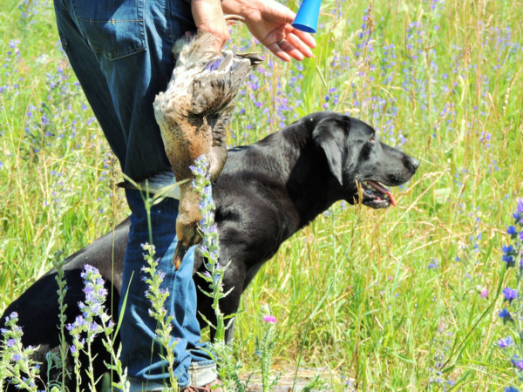
Evaluating the Master Dog:
Lining the Dog
In marking situations, the handler should not line a dog with his or her hand in the direction of any fall or gun station until all falls are down
A handler may give the dog a line in the direction of the fall, provided that such lining is accomplished briskly and precisely
Conspicuously intensive lining with the hand suggests a weak marking ability and the dog must be graded low in marking
Notes:
“In marking situations, a handler may give the dog a line in the direction of the fall, provided that such lining is accomplished briskly and precisely. Conspicuously intensive lining suggests a weak marking ability and the dog must be graded low in marking. The handler shall NOT line a dog in the direction of any fall or gun station until all the falls are down.”
- Section 12.6 pg. 46

Slide 19
Evaluating the Master Dog:
Talking to the Dog
Handlers of the working and honouring dogs should ideally remain silent from first shot until dog is released by the judge
Repeatedly speaking to the dog within one or more than one series indicates an undesirable lack of steadiness or marking ability and must be scored “0”
However, the handler may very quietly give an occasional command on an unclear mark without incurring a penalty
A handler may speak quietly to the dog to prevent forward motion (controlled break) but repetition of this will require “0” in trainability
At any time, if the judges deem the handler to be loud or intimidating, the dog will be scored “0”
If the handler of an honouring dog makes a loud noise or command which might interfere with a competing dog, the judge at her/his discretion may disqualify the offending team

Slide 20
Evaluating the Master Dog: Recasting the Dog
A dog should be sent to retrieve only once
A recast occurs when a dog leaves for a mark, but stops within a short distance (approximately 5 yards/4.5 meters) and returns or is recalled after which the dog is sent again
This can result from the dog’s confusion as to whether it was actually sent
It is NOT considered a recast when the dog goes to the fall area, fails to find the bird or blinks a bird it has found, and returns or is recalled
This is regarded as lack of perseverance and can merit “0” in marking or perseverance unless the judges perceive valid mitigating circumstances
Notes:
Discussion should take place at this point by asking the question, “How do you distinguish between a refusal and confusion?”
Factors to consider are:
Did the dog hear the command?
Was the command too loud so as to startle the dog?
Could the conditions that the dog is expected to enter be considered to test their perseverance such as cold or murky water (possibly leading to refusal)

Slide 21
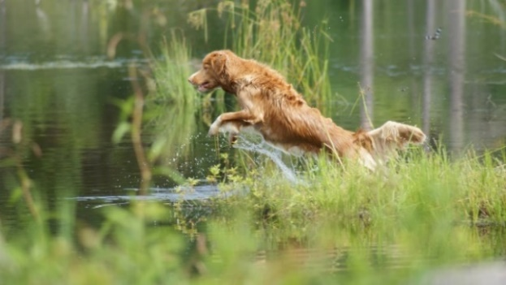
Evaluating the Master Dog: Handling on Marks
Dogs may be handled on marks but excessive handling requires a lower score in perseverance and must be scored more stringently in marking and perseverance than in Senior
A dog that goes to the area of the fall and finds the bird unaided should be scored appreciably higher than a dog that must be handled to a bird
Master dogs that require excessive handling on marks and blinds, refuse voice or hand whistles or who appear reluctant to work must be viewed differently from the not-so-seasoned Senior dogs where a degree of tolerance is necessary

Slide 22
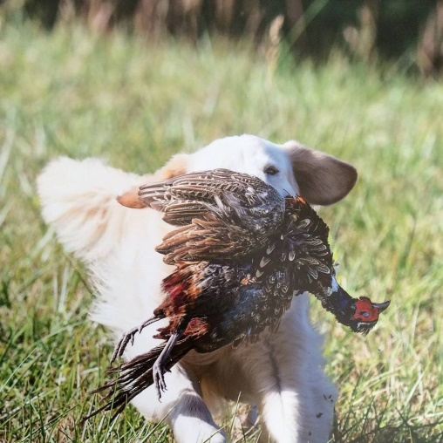
Evaluating the Master Dog: Interference
In the case of another dog breaking for the same fall as the working dog and interfering with the working dog that in any way causes a faulty performance, the working dog should be considered as not having been tested and given another opportunity to be evaluated
If the handler of an honouring dog makes a noise or command which might interfere with the working dog, the judges have discretion to remove the offending team from the test

Slide 23
Evaluating the Master Dog: Switching
A dog is considered to have switched if it:
  Goes to the area of a fall, hunts, fails to find the bird and then leaves the area to hunt for another fall; or
  Drops a bird it is retrieving and goes for another bird
Unless the judges agree that valid mitigating circumstances exist, a dog that switches shall be scored “0” in perseverance and eliminated
It should NOT be considered a switch, and therefore lack of perseverance, if the dog:
  Finds another bird on the way to one fall and retrieves it first, or
  Changes direction before reaching the area of one fall, does not establish a hunt and retrieves another bird

Slide 24
Evaluating the Master Dog: Hard Mouth
Hard mouth is one of the most undesirable traits in a retriever
A dog can carry the stigma for life and therefore hard mouth requires incontrovertible proof
Torn skin or flesh alone is not usually sufficient evidence for proof as it may be caused in a variety of ways, such as by sharp sticks or stones, etc. in the cover as well as by the dog’s fast, positive pick-up
Crushed bone structure can usually be accepted as trustworthy and sufficient evidence of hard mouth

Slide 25
Evaluating the Master Dog: Hard Mouth Cont’d
Other undesirable traits are frequently confused with hard mouth such as freezing with bird in mouth
A hard mouthed dog may still have a gentle delivery and a reluctant or sticky delivery does NOT imply hard mouth
Rolling or mouthing the bird during a retrieve may be erroneously associated with hard mouth as well even when the bird is not damaged
Such mouthing may not necessarily call for a lowering of a trainability score
The judge should remember a dog either does or does not have a hard mouth, and if it does, cannot receive a qualifying score

Slide 26
Evaluating the Master Dog: Sample Score Sheet 1
Notes:
A Master test usually consists of the following 5 series: - Land marks, Water marks, Land blind, Water blind, Quarter and flush
To qualify, an average score of 7 for the whole test (all series) must be achieved and must NOT include an average score below 5 in any one ability (Marking, Style, Perseverance, Trainability)
Possible Scoring Methods:
Determine whether dog should qualify in that ability category, which might mean an ability score of 5. Knowing the dog must have an overall average of 7, the judge considers whether other abilities deserve a 7 or higher. With a five or less (but not with a zero by both judges), the dog would have to score higher in that ability and other abilities to acquire the 7 overall average.
A judge might want to compare the scores to grades received in school. For example, a 5, 6 or 7 might be comparable to a passing grade of C, an 8 would be a B, etc.
Another method could begin with a perfect score of 10 and progress downward.
Judges should take time to review and check their scores with each other before their scores become final.
The score sheet sample above represents a SOLID PASS.

Slide 27
Evaluating the Master Dog: Sample Score Sheet 2
Notes:
Master test usually consists of the following 5 series: - Land marks, Water marks, Land blind, Water blind, Quarter and flush
To qualify, an average score of 7 for the whole test (all series) must be achieved and must NOT include an average score below 5 in any one ability (Marking, Style, Perseverance, Trainability)
Possible Scoring Methods:
Determine whether dog should qualify in that ability category, which might mean an ability score of 5. Knowing the dog must have an overall average of 7, the judge considers whether other abilities deserve a 7 or higher. With a five or less (but not with a zero by both judges), the dog would have to score higher in that ability and other abilities to acquire the 7 overall average.
A judge might want to compare the scores to grades received in school. For example, a 5, 6 or 7 might be comparable to a passing grade of C, an 8 would be a B, etc.
Another method could begin with a perfect score of 10 and progress downward.
Judges should take time to review and check their scores with each other before their scores become final.
The score sheet sample above represents a CLEAR FAIL as the dog blew up in the 4th series - water marks.

Slide 28
Evaluating the Master Dog: Sample Score Sheet 3
Notes:
Master test usually consists of the following 5 series: - Land marks, Water marks, Land blind, Water blind, Quarter and flush
To qualify, an average score of 7 for the whole test (all series) must be achieved and must NOT include an average score below 5 in any one ability (Marking, Style, Perseverance, Trainability)
Possible Scoring Methods:
Determine whether dog should qualify in that ability category, which might mean an ability score of 5. Knowing the dog must have an overall average of 7, the judge considers whether other abilities deserve a 7 or higher. With a five or less (but not with a zero by both judges), the dog would have to score higher in that ability and other abilities to acquire the 7 overall average.
A judge might want to compare the scores to grades received in school. For example, a 5, 6 or 7 might be comparable to a passing grade of C, an 8 would be a B, etc.
Another method could begin with a perfect score of 10 and progress downward.
Judges should take time to review and check their scores with each other before their scores become final.
The score sheet sample above should be discussed. In this case, the dog was carried to the final series as a numerical pass is still possible after each series. The poor quarter in the final series resulted in a failing score.

Slide 29
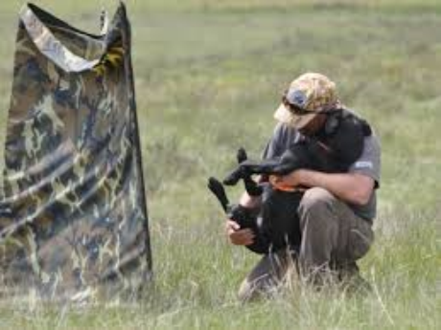
Perhaps Above All
Hunt tests should be an enjoyable sport in which handlers and their dogs get to work as a team and have fun
Thank you!

